Slide 1
Custom LDO design & Basic Op Amp Ciruits

Slide 2
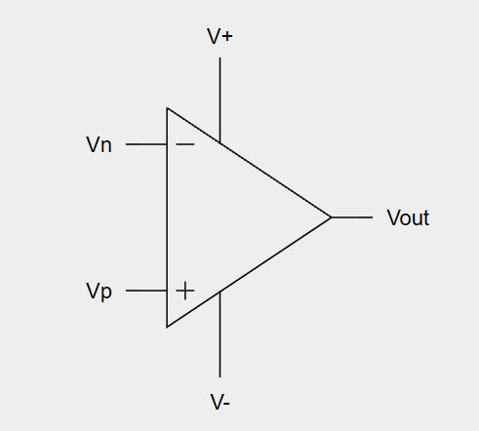



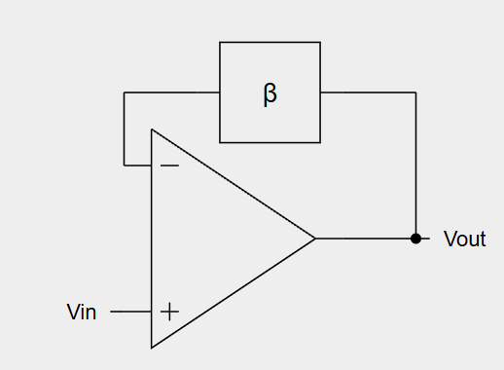
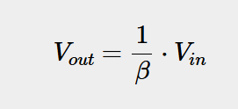
Basic Op Amp Circuit – Fundamantials

Slide 3
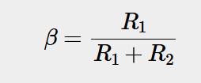
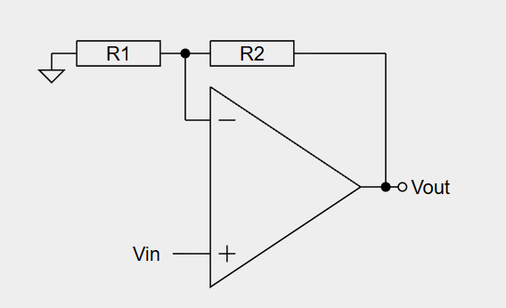


Basic Op Amp Circuit – Not Inverting Amplifier

Slide 4
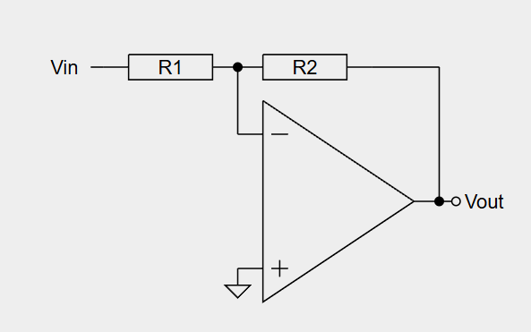

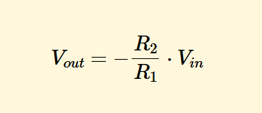
Basic Op Amp Circuit – Inverting Amplifier

Slide 5
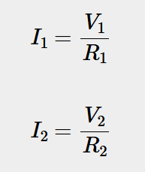

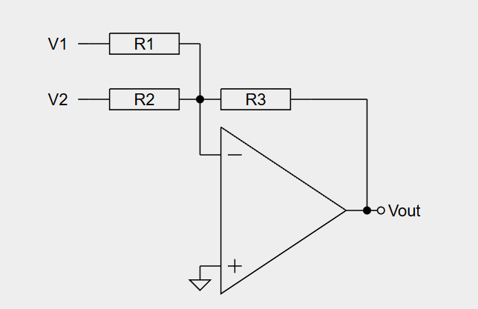


Basic Op Amp Circuit – Summing Amplifier
s

Slide 6

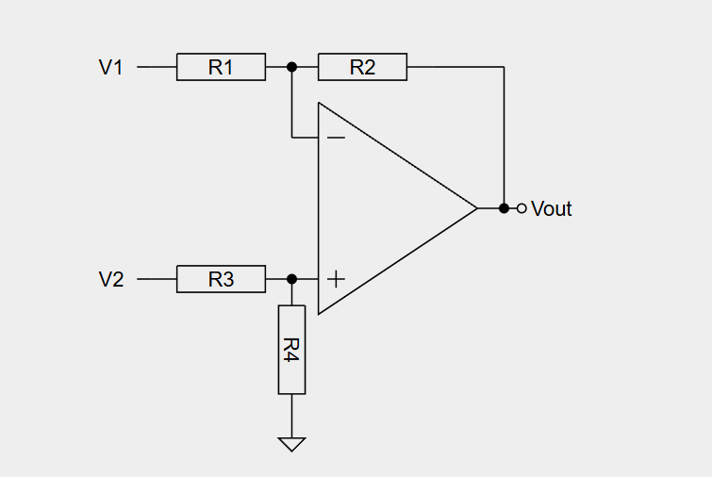



Basic Op Amp Circuit – Diffirential Amplifier

Slide 7
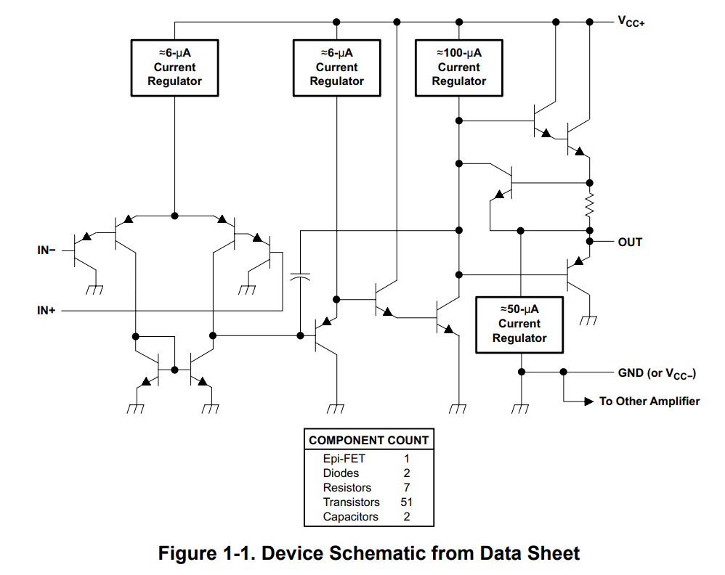
LDO Desing – Op Amp selection
LM358P Op amp;

Slide 8
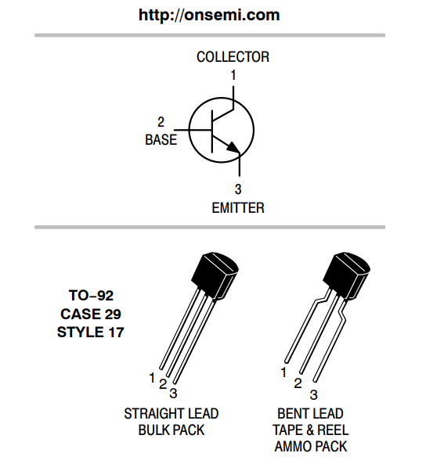
LDO Desing – Transistor Selection
2222A NPN transistor;

Slide 9
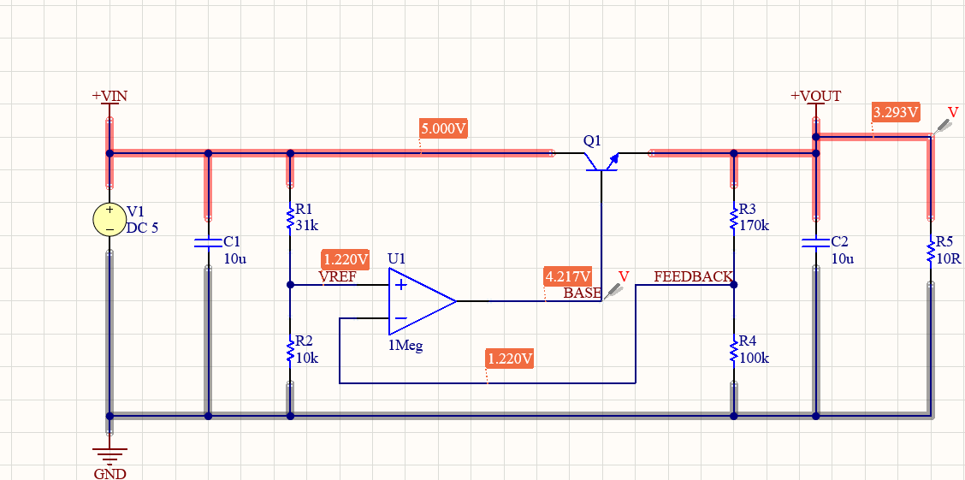
LDO Desing – Basic LDO Circuit Desing

Slide 10


